Slide 1
3D printing Workflow
Design the part in Solidworks 2020 & check for clearance using an assembly in SW 2020
Upload SW file (.sldprt) to respective teams subgroups (eg. If you are group 6, upload to Group 6 subgroup under 2110 Teams page)
Naming convention: ddmmyy_grpno_filename
Make a message on Teams subgroup and tag Badri
Wait for Badri's feedback & collect thumbdrive (for printing)
Use PrusaSlicer to slice and generate gcode for printing
Export gcode to thumbdrive and start print

Slide 2
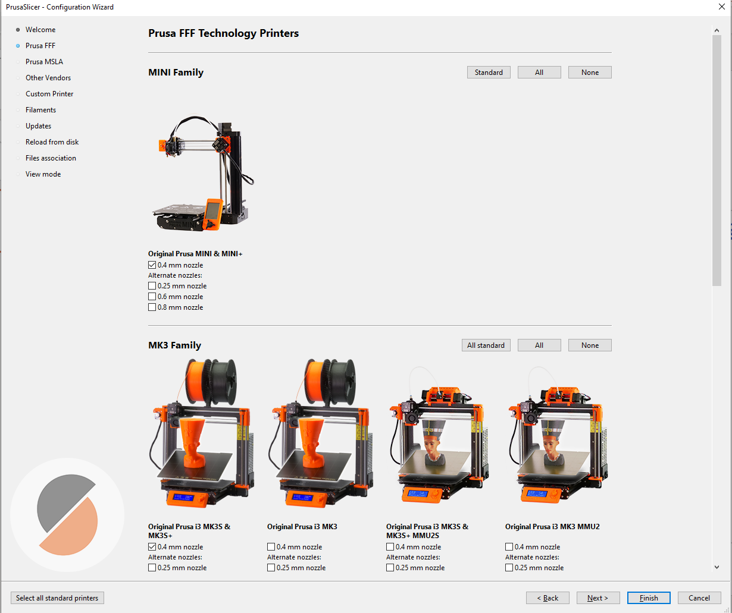
PrusaSlicer Set-up Guide
PursaSlicer software and video guides can be found here
On the first launch of the software you would be asked to add the printer & configure the settings. Under the PRUSA FFF tab, select Prusa MINI (0.4mm nozzle)

Slide 3
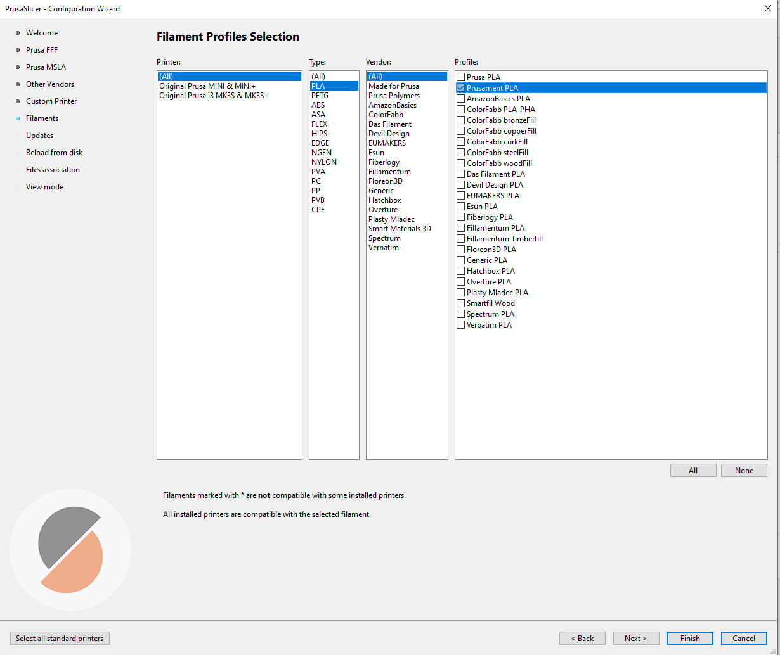
PrusaSlicer Set-up Guide
Skip until you reach the Filaments tab
Select the Prusament PLA

Slide 4
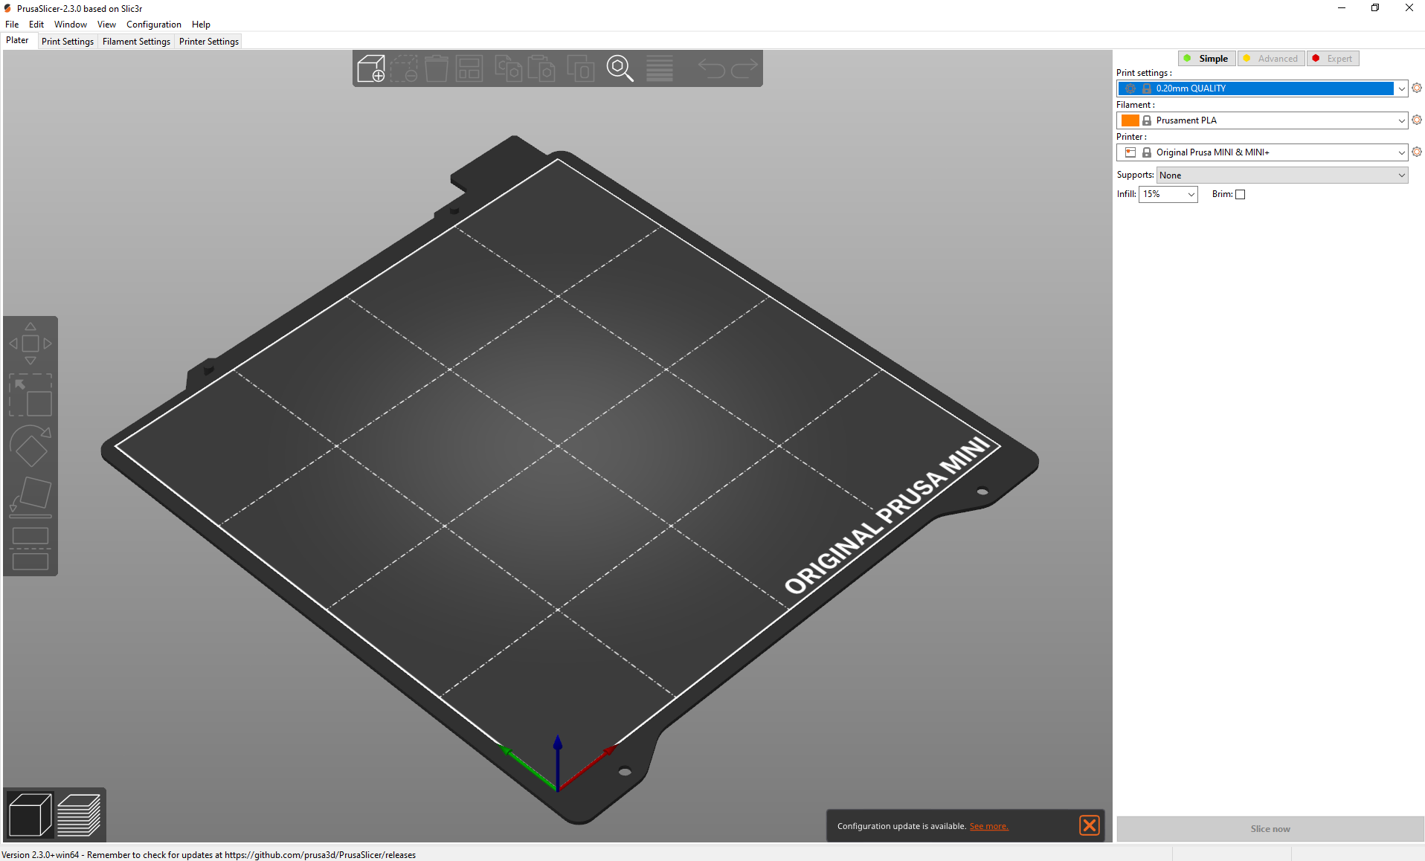
PrusaSlicer Set-up Guide
Once you finish the set-up you would come to this page
To import a STL file to PrusaSlicer, go to File → Import → STL
Once you have imported you can reorient the STL file using the translucent tab on the left

Slide 5
PrusaSlicer Set-up Guide
The settings to the right of the screen indicate the print quality settings
As a rule of thumb do keep the settings preview to simple or advanced
Print settings
Print settings : User defined
Filament : Prusament PLA
Printer: Original Pursa MINI & MINI+
Supports : User defined
Infill : User defined (for prototyping typically 15% is sufficient)
Brim: Ticked

Slide 6
PrusaSlicer Set-up Guide
Press the slice button on the bottom right to slice the STL
You can scroll through the layers using the orange arrow marker found on the left of the print settings section
Press “Export gcode” button to save the file to the thumbdrive
Naming convention: ddmmyy_grpno_filename
Plug the thumbdrive into the Prusa MINI and start the print

